Slide 1

Bookstore SQL Data Analysis
By
Vaibhav Bari

Slide 2
SQL Queries

Slide 3
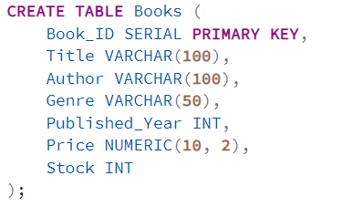
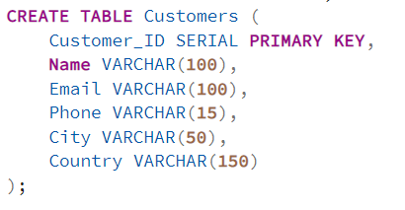
Schemas
1- Book table
2- Customer table
By Vaibhav Bari

Slide 4
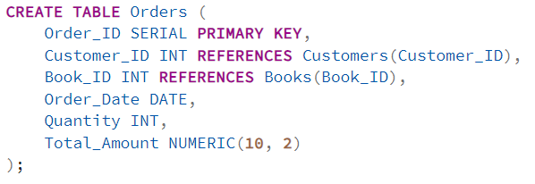
Schemas
3- Order table
By Vaibhav Bari

Slide 5
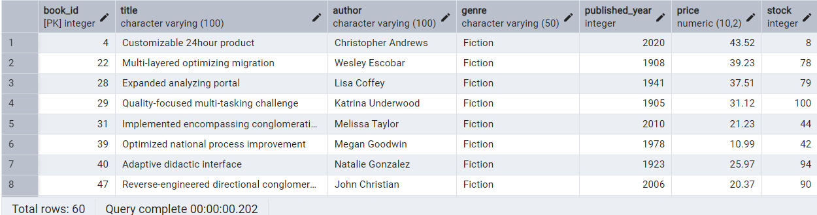

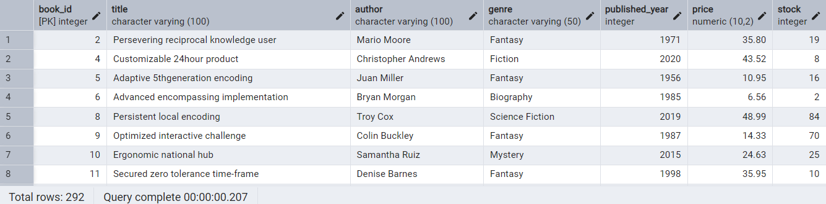

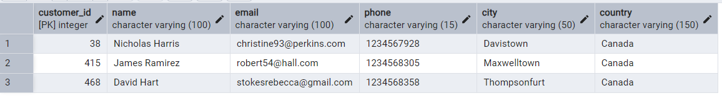

SQL Queries
1) Retrieve all books in the "Fiction" genre
2) Find books published after the year 1950
3) List all customers from the Canada
By Vaibhav Bari

Slide 6
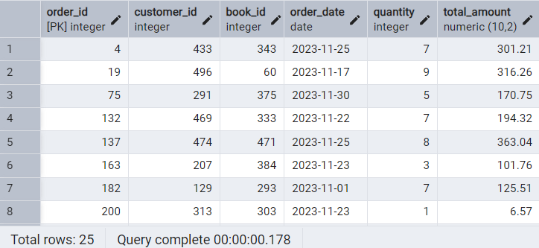




SQL Queries
4) Show orders placed in November 2023
5) Retrieve the total stock of books available
6) Find the details of the most expensive book
By Vaibhav Bari

Slide 7
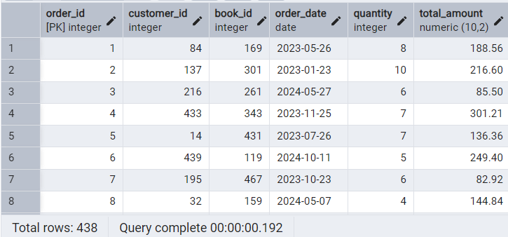

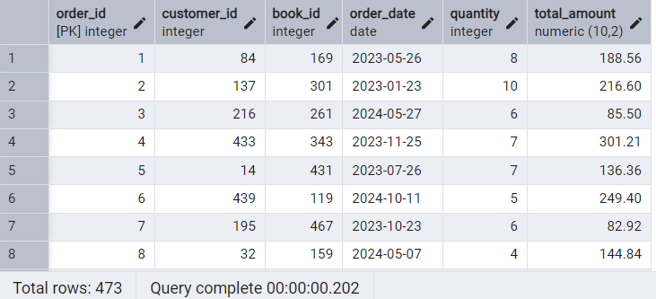

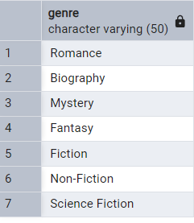

SQL Queries
7) Show all customers who ordered more than 1 quantity of a book
8) Retrieve all orders where the total amount exceeds $20
9) List all genres available in the Books table
By Vaibhav Bari

Slide 8



SQL Queries
10) Find the book with the lowest stock
11) Calculate the total revenue generated from all orders
By Vaibhav Bari

Slide 9
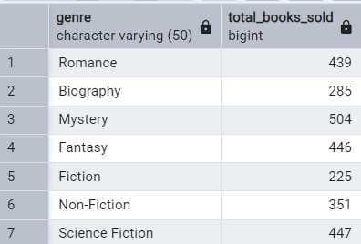
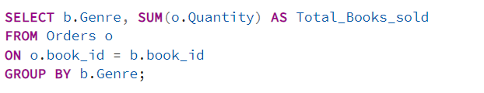
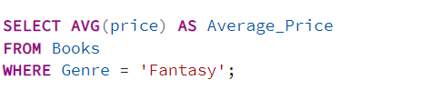

SQL Queries
12) Retrieve the total number of books sold for each genre
13) Find the average price of books in the "Fantasy" genre
By Vaibhav Bari

Slide 10
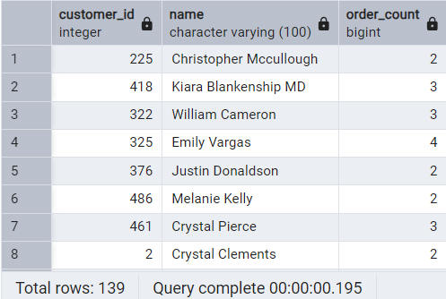
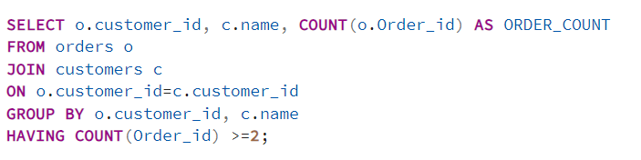
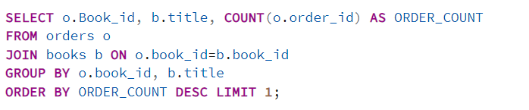

SQL Queries
14) List customers who have placed at least 2 orders
15) List customers who have placed at least 2 orders
By Vaibhav Bari

Slide 11
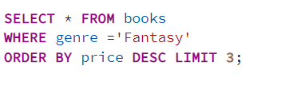
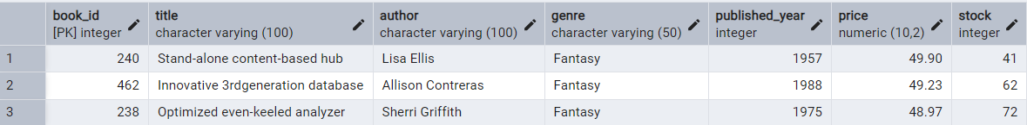
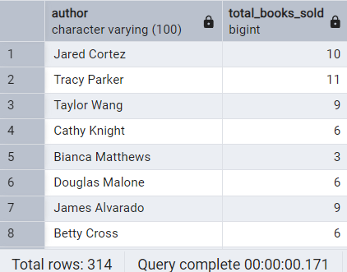
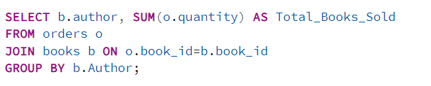
SQL Queries
16) Show the top 3 most expensive books of 'Fantasy' Genre
17) Retrieve the total quantity of books sold by each author
By Vaibhav Bari

Slide 12
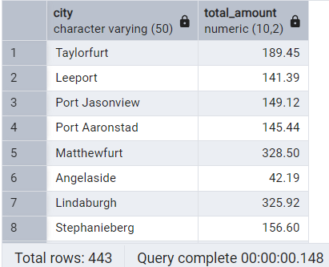
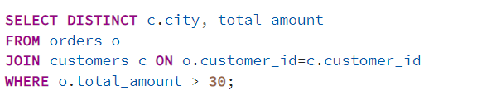
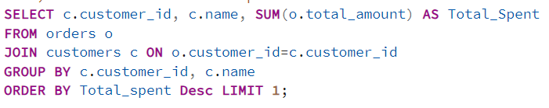

SQL Queries
18) List the cities where customers who spent over $30 are located
19) Find the customer who spent the most on orders
By Vaibhav Bari

Slide 13
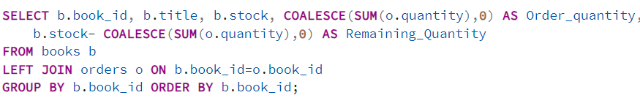
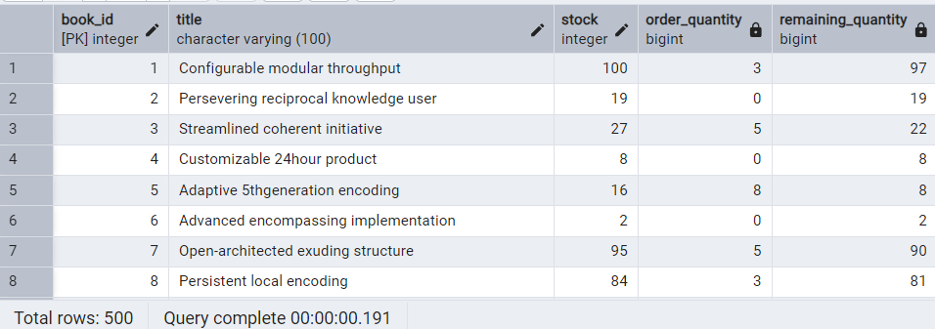
SQL Queries
20) Calculate the stock remaining after fulfilling all orders
By Vaibhav Bari

